Slide 1
Project Presentation
Interpreting Doctors Note Using Handwriting Recongnition And Deep Learning Technique
MITU22BTCS0026 Tejas Raut MITU22BTCS0760 Shailaja Rautrao MITU22BTCS0802 Shruti Thorat MITU22BTCS0503 Om Talekar
Guided By
Dr.Sunita Parinam
Department of Computer Science & Engineering, MITSoC, Loni Kalbhor

Slide 2
Outline
Introduction
Problem Statement
Objectives
Concepts And Methods
Tools And Languages
Process And Architecture
Block Diagram
Results
Conclusion And Future Work
References

Slide 3
1.Introduction
.
Doctors’ handwritten notes are often illegible, leading to errors in medical communication. This project uses AI and deep learning techniques, including OCR, CNNs, and RNNs, to automatically convert handwritten medical notes into digital text. The system enhances accuracy, reduces manual effort, and improves documentation in healthcare settings

Slide 4
2.Problem Statement
Doctors often write prescriptions and notes in unclear handwriting, which makes it hard for pharmacists and medical staff to read them correctly. This can cause confusion, delays in treatment, and even serious medical errors. Regular OCR tools struggle with messy handwriting, especially in the medical field. To solve this, we need an AI-based system that can accurately read and convert handwritten doctors’ notes into digital text, making healthcare records easier to understand and manage.

Slide 5
3.Objectives
To develop an AI-based system that can read and understand handwritten doctor’s notes.
To use deep learning techniques like CNN and LSTM for accurate handwriting recognition.
To convert handwritten medical text into clear, readable digital format.
To reduce manual transcription errors and save time for medical staff.
To improve communication, safety, and efficiency in healthcare documentation.

Slide 6
4.Concept and Methods
Handwritten prescriptions are preprocessed using Pillow for noise reduction and clarity.
Pytesseract performs OCR to extract meaningful text from the image.
Pandas structures and cleans raw OCR output using regex for accuracy.
Requests + BeautifulSoup4 are used to fetch drug information from trusted medical websites.
Data privacy is considered using Flask’s secure routes and optional encryption.
The end goal: Convert messy handwriting into structured, understandable data.

Slide 7
5.Tools and Languages
Flask – Powers the web interface and routes for uploading and displaying results.
Pytesseract – Recognizes and extracts handwritten text from images using OCR.
Pillow – Preprocesses images (resize, grayscale, denoise) for better OCR accuracy.
Pandas – Cleans, formats, and structures extracted text data into readable tables.
Requests + BeautifulSoup4 – Scrapes additional drug info (usage, dosage) from the web.
Entire stack is Python-based, ensuring easy integration and modularity.

Slide 8
6.Process and Architecture
Pillow enhances the image for better OCR Accuracy.
Pytesseract extracts text from the image using OCR.
Pandas fromats and cleans the extracted text into structured data.
Clean data is displayed, with optional drug info fetched via web scrapping.
User uploads a handwritten prescription image through the Flask interface.

Slide 9
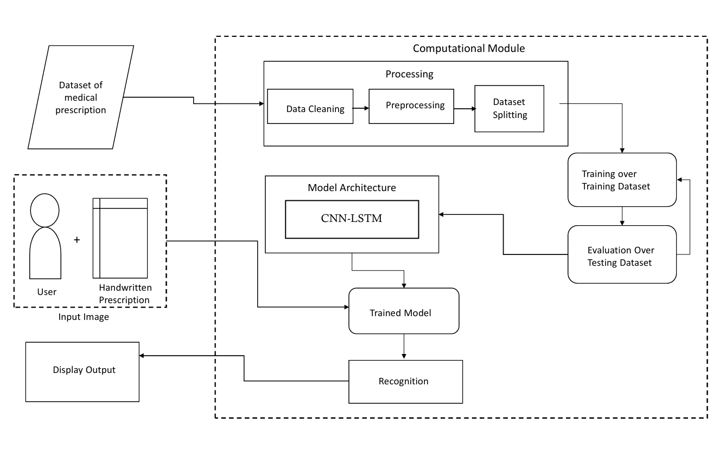
7.Block Diagram

Slide 10
8.Results
The system effectively converts handwritten prescriptions into structured,
editable data. By preprocessing images with Pillow and using pytesseract
for OCR, the accuracy of text extraction is significantly improved.
The integration of web scraping further enriches the extracted information
with drug details, providing users with clear, reliable, and accessible results
for informed decision-making.

Slide 11
9.Conclusion and Future Work
Conclusion: The system successfully extracts and organizes data from handwritten
prescriptions, improving accuracy through image preprocessing and OCR.
It also integrates valuable drug information, enhancing the user experience.
Future Work: Incorporating more advanced NLP techniques to further improve
text recognition, adding support for multiple languages, and expanding the
database for drug information are potential areas for enhancement.
We also aim to integrate AI-based error correction for better accuracy.

Slide 12
10. References
Tesseract OCR Documentation: https://github.com/tesseract-ocr/tesseract
Flask Documentation: https://flask.palletsprojects.com/
Pillow Documentation: https://pillow.readthedocs.io/
Pandas Documentation: https://pandas.pydata.org/
BeautifulSoup Documentation: https://www.crummy.com/software/BeautifulSoup/
Python Requests Library: https://requests.readthedocs.io/

Slide 13
Thank You

